Slide 1

Investment in House Property between Round Rock, TX & Los Angeles County
Liyan cen
Springboard: Foundations of Data Science CAPSTONE project

Slide 2
Background
Buying real estate is about more than just finding a place to call home. Investing in real estate has become increasingly popular over the last 50 years and has become a common investment vehicle.
As a Real Estate agent, I am helping my clients who are interested in investing in house properties in both Round Rock and Los Angeles.

Slide 3
County of Los Angeles
The County of Los Angeles is home to more than one-quarter of California residents and is one of the most ethnically diverse counties in the U.S.
Los Angeles County is commonly associated with the entertainment and digital media industry; all six major film studios—Paramount Pictures, 21st Century Fox, Sony, Warner Bros., Universal Pictures, and Walt Disney Studios—are located within the county.

Slide 4
County of Los Angeles – continued
Home prices in Los Angeles are quickly getting out of reach for many residents, according to a new report from the California Association of Realtors. It finds that just one in four residents of LA County make enough to afford a median-priced home in the area.
A typical LA County home cost $553,330 in the fourth quarter of 2017.

Slide 5
Austin, Texas
Austin is considered to be a major center for high tech.
The region's rapid growth has led Forbes to rank the Austin metropolitan area number one among all big cities for jobs for 2012 in their annual survey.
Austin's largest employers include the Austin Independent School District, the City of Austin, Dell, the U.S. Federal Government, NXP Semiconductors, IBM, St. David's Healthcare Partnership, Seton Family of Hospitals, the State of Texas, the Texas State University, and the University of Texas at Austin.

Slide 6
Round Rock, Texas
Round Rock is a city in the U.S. state of Texas, in Williamson County (with a small part in Travis), which is a part of the Greater Austin, Texas .
In August 2008, Money magazine named Round Rock as the seventh-best American small city in which to live. Round Rock was the only Texas city to make the Top 10. In a CNN article dated July 1, 2009, Round Rock was listed as the second fastest-growing city in the country, with a population growth of 8.2% in the preceding year.

Slide 7
Round Rock, Texas - continued
In the Austin-Round Rock MSA, the median price of single-family homes increased by 3.6 percent year-over-year in January 2018 to $290,000. Home sales increased by 8.5 percent to 1,655 sales, citing continual demand. Housing inventory of single-family homes in the Austin-Round Rock MSA stayed at 1.9 months of inventory, the same as last January.

Slide 8
The Problem
This project is customized for clients who are interested in investment property in both Round Rock, Texas and Los Angeles County. With respect to the data collected for the two Metropolitan Area, over the years, we present the client the comparison between two cities regarding investing purpose. I will analyze data on the “house price index”, "Population trend", "Demographics", and “unemployment rate” for both cities.

Slide 9
Limitations
While these factors are important to consider for investing purpose, investors may also think about other factors like operating expenses, property tax rates, financing conditions, etc., which are not covered in our datasets.

Slide 10
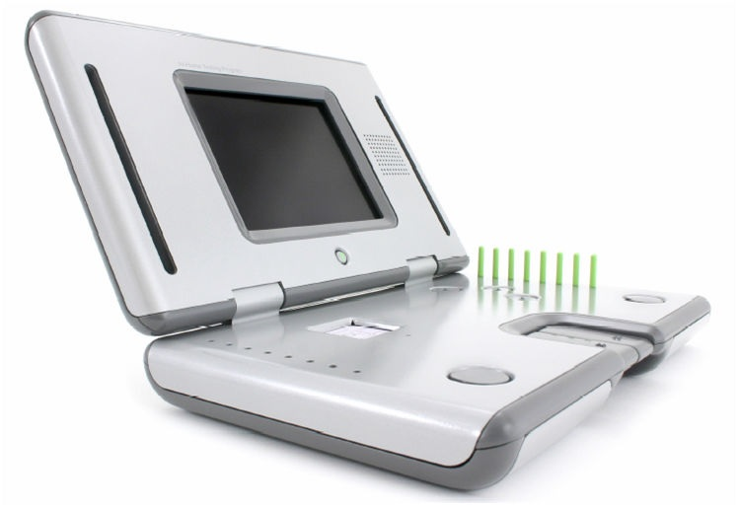
A Solution
Based on the data I collected for two cities on house price index, "Population trend", "Demographics", and an unemployment rate, I used “Data Wrangling” and “ EDA” to clean and analyze those datasets.

Slide 11
The Dataset
Economic Research Federal Reserve Bank of ST.LOUIS
All-Transactions House Price Index for Austin-Round Rock-San Marcos, TX (MSA)
Unemployment Rate in Austin-Round Rock, TX (MSA)
All-Transactions House Price Index for Los Angeles County, CA
Unemployment Rate in Los Angeles County, CA
Wikipedia
Round Rock, Texas - Demographics
Los Angeles, County - Demographics
Notes:
Challenges – redundancy of 2/4 replicate recordings, non-independent due to small number of patients

Slide 12
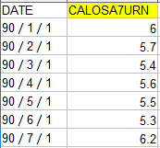
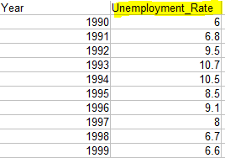
Data Wrangling
names()
>names(LA_Unemployment_Original)[2] <- "Unemployment_Rate"

Slide 13
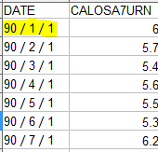
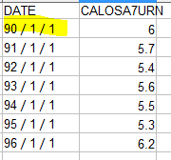
Data Wrangling
endsWith()
>a <- endsWith(as.character(LA_Unemployment_Original$Year), “/1/1") # Which rows to keep (kp)?
LA_Unemployment_Clean <- LA_Unemployment_Original[a, ]

Slide 14
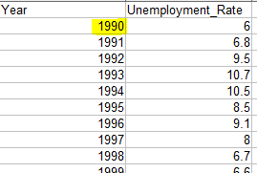
Data Wrangling
year()
>LA_Unemployment_Clean$Year <-year(as.Date(LA_Unemployment_Clean$Year, "%y"))
>Round_Rock_Unemployment_Clean$Year <-
year(as.Date(Round_Rock_Unemployment_Clean$Year, "%y"))

Slide 15
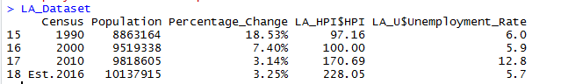
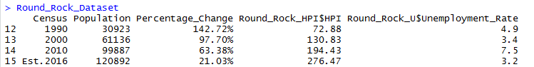
Data Wrangling
cbind()
> LA_Dataset
<- cbind(LA_P, LA_HPI$HPI, LA_U$Unemployment_Rate)
Round_Rock_Dataset <- cbind(Round_Rock_P, Round_Rock_HPI$HPI, Round_Rock_U$Unemployment_Rate)

Slide 16
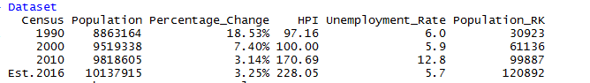
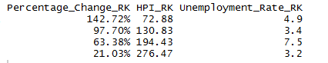
Data Wrangling
merge()
> Dataset <- merge(LA_Dataset, Round_Rock_Dataset, all = TRUE, by.x = "Census", by.y = "Census")
> names(Dataset)[2:9] <- c("Population", "Percentage_Change", "HPI", "Unemployment_Rate", "Population_RK", "Percentage_Change_RK", "HPI_RK","Unemployment_Rate_RK")

Slide 17
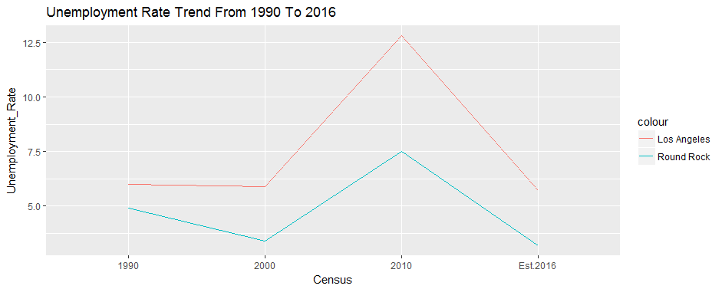
EDA – Unemployment Rate
The unemployment rate is a measure of the prevalence of unemployment and it is calculated as a percentage by dividing the number of unemployed individuals by all individuals currently in the labor force. By checking out the line chart "Unemployment Rate Trend From 1990 To 2016", we can see that the rates are not stable over the years, especially during 2000, and 2010. Comparatively, Round Rock is in a more stable condition, with a smaller scale.
Unemployment is an important factor that the investor should consider because the healthier the job market is, the more prosperous the house market will be. Since Los Angeles County is a larger economy system than Round Rock, it is reasonable that the unemployment rate is less stable, which might be an indicator that houses in LA might encounter larger fluctuations than it would in Round Rock if economic recession or depression occurs in the future.
Notes:
Clustering, Plotting
Plotting informed final decision based on these two types of plots

Slide 18
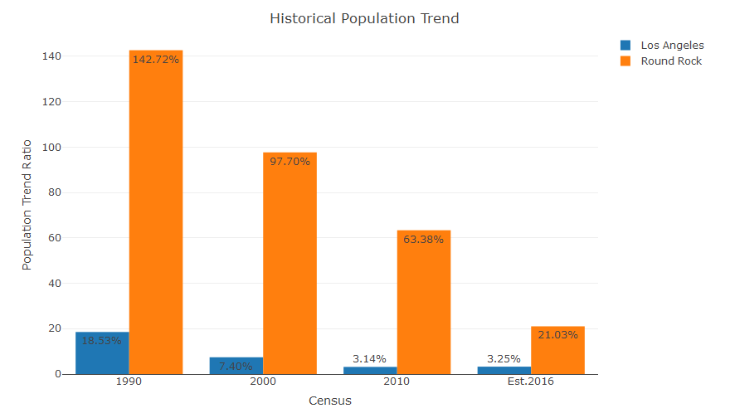
EDA – Population Growth
According to the Bar plot of "Historical Population Trend", we can see that both populations are increasing, while Round Rock's trend is increasing in a larger proportion. In 2016, the population growth rate in Los Angeles County, and Round Rock are 3.25% and 21.03% respectively.
The population growth in Los Angeles is getting much slower that Round Rock, because Los Angeles county is a pretty developed city where growth potential has reached its limit. On the other side, Population in Round Rock keeps growing over the last couple of years. Also, unlike Los Angles, Round Rock is far from developed, it is still a growing city.
Notes:
Clustering, Plotting
Plotting informed final decision based on these two types of plots

Slide 19
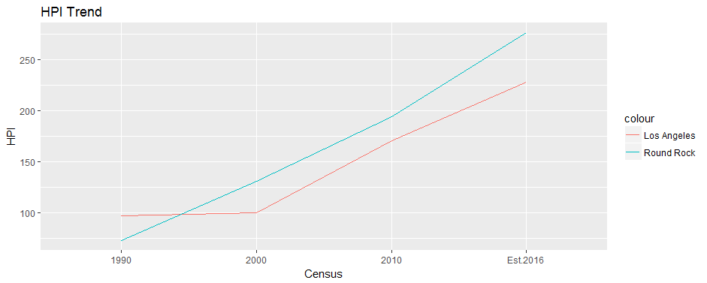
EDA - HPI
The HPI is a broad measure of the movement of single-family house prices. The HPI is a weighted, repeat-sales index, which means that it measures average price changes in repeat sales or refinancing on the same properties. Based on the linear regression "HPI Trend", we can see that the both HPIs are on an increasing trend while Round Rock has a higher HPI with more stability and larger sale.
Notes:
Clustering, Plotting
Plotting informed final decision based on these two types of plots

Slide 20
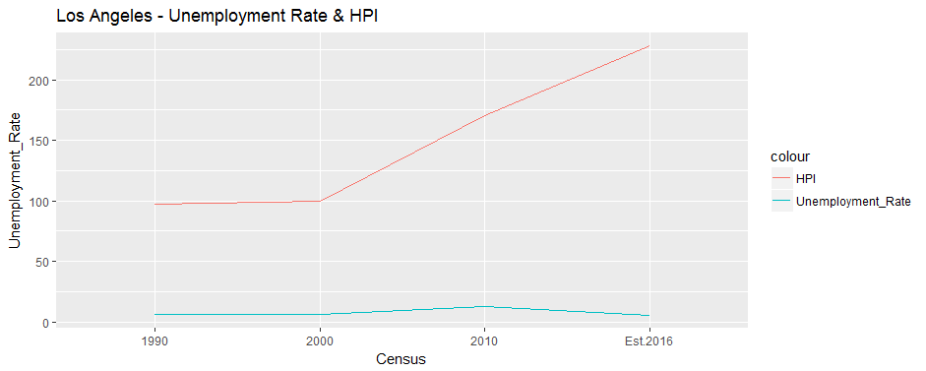
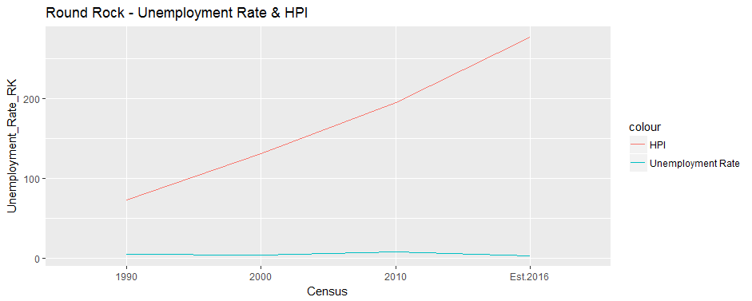
EDA – HPI continued
On the other hand, by comparing both " Los Angeles - Unemployment Rate & HPI" and " Round Rock - Unemployment Rate & HPI", there is an inverse relationship between unemployment rate and HPI. As the unemployment increases, the HPI decrease, vice versa. This might illustrate an idea that while the job market is healthy, people are willing to buy houses.
Notes:
Clustering, Plotting
Plotting informed final decision based on these two types of plots

Slide 21
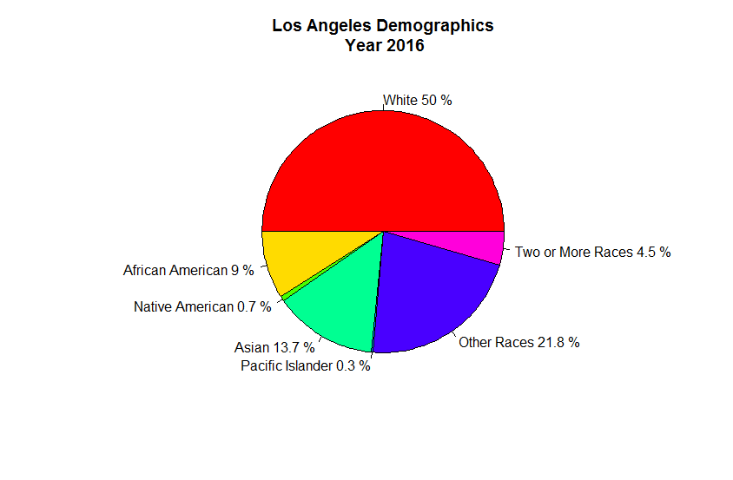
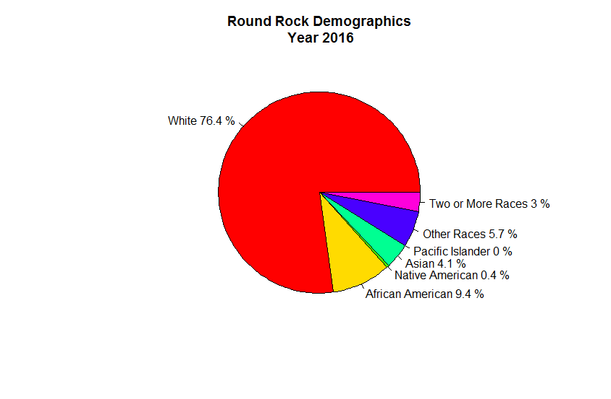
EDA - Demographics
Client should also consider Demographics as an important factor if he or she in interested in buying a house for both investing and residential purpose. Demographics is a good reference for how the culture, diversity, and community life could be in the city they are interested in.
Notes:
Clustering, Plotting
Plotting informed final decision based on these two types of plots

Slide 22
Conclusion
When buying investment property, there is more to consider besides the dataset I have analyzed, like “ property tax”, “down payment”, “ Return rate”, “ Operating expenses”, and more.
However…

Slide 23
Improve Training Data
The two cities I studied on are completely two different kind of counties in US.
Depending on client’s need, and budget, the datasets I have so far gives them a general idea about how to compare these two counties.

Slide 24
Thank You!!

